Slide 1
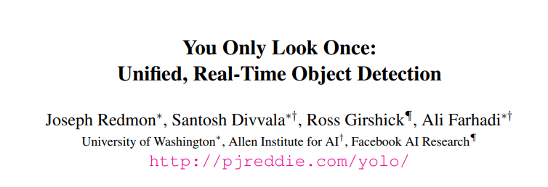
Yesim Selcuk
KISTI
28/11/2022

Slide 2
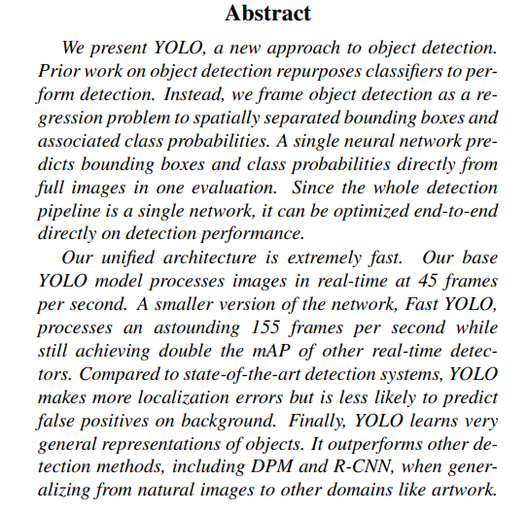
Main Goal
An object detection approach is framed as a regression problem.
A single neural network predicts bounding boxes and class probabilities directly from full images in one evaluation.

Slide 3
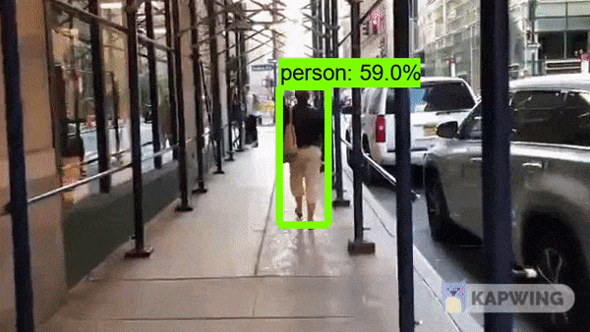
Introduction
In current systems, they repurpose classifiers to perform detection. These systems work basically in this sequence:
It takes classifier for that object
Evaluate it at various locations
It scales in test image

Slide 4
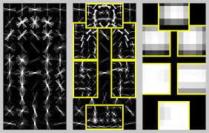
Introduction
There are some systems such as Deformable Parts Models (DPM) use a sliding window approach where the classifier is run at spaced locations over the entire image.

Slide 5
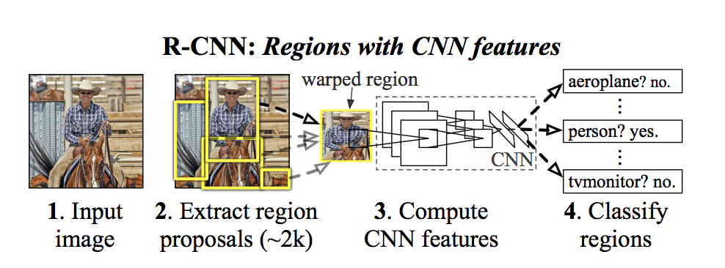
Introduction
Most recent approaches such as R-CNN use region proposal methods to first generate potential bounding boxes in an image and then run a classifier on these proposed boxes.
Afterward, post-processing is used to refine the bounding boxes, eliminate duplicate detections and rescore the boxes based on other objects in the scene.
Notes:
However, this process are slow and hard to optimize. The reason behind is that each individual component must be trained separately.

Slide 6
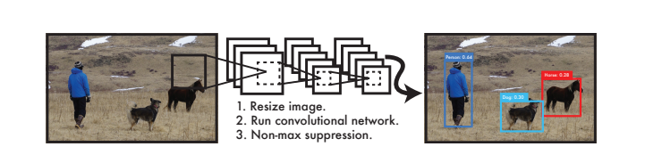
YOLO Detection System
In this paper, the object detection called YOLO is framed as a regression problem which is straight from image pixels to bounding box coordinates and class probabilities.
Notes:
A single convolutional network simultaneously predicts multiple bounding boxes and class probabilities for those boxes. YOLO trains on full images and directly optimizes detection performance. Therefore, it has several benefits.

Slide 7
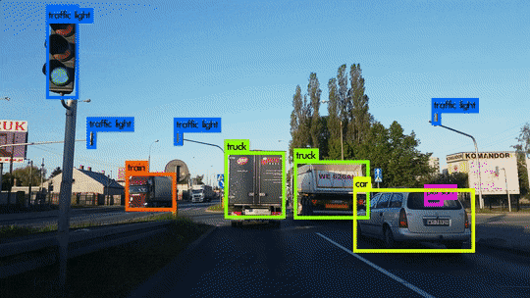
The Advantages of YOLO Detection System
YOLO reasons globally about the image when making predictions.
YOLO learns generalizable representations of objects which means that it less likely to break down when applied to new domains or unexpected inputs.
Notes:
Instead of sliding window and region proposal-based techniques, YOLO sees the whole image which means that it encodes contextual information about classes as well as appearance.
However, in Fast R-CNN which is a top detection model, it mistakes background patches in an image for objects because it cannot see the larger context.

Slide 8
The Disadvantages of YOLO Detection System
Yolo still struggles localize some objects, especially small ones.
In addition, it still lags behind the state-of-the-art detection systems in accuracy.

Slide 9
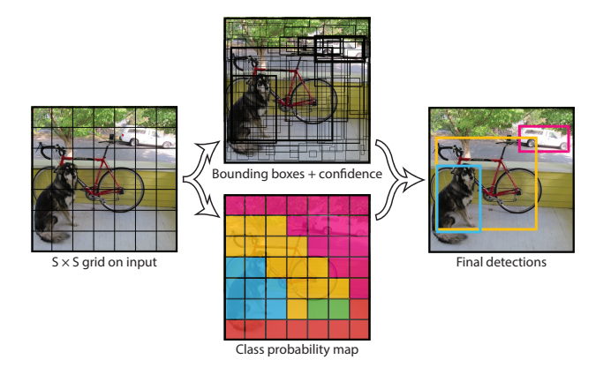
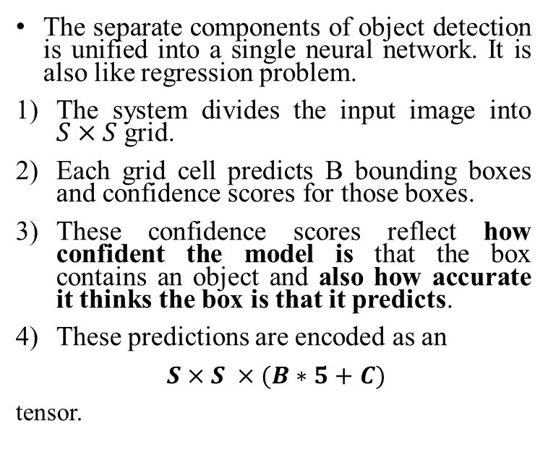
Unified Detection
The separate components of object detection is unified into a single neural network. It is also like regression problem.
The system divides the input image into $S×S$ grid.
Each grid cell predicts B bounding boxes and confidence scores for those boxes.
These confidence scores reflect how confident the model is that the box contains an object and also how accurate it thinks the box is that it predicts.
These predictions are encoded as an
$S×S ×(B∗5+C)$
tensor.
Notes:
It also predicts all bounding boxes across all classes for an image simultaneously which means that the network reasons globally about the full image.

Slide 10
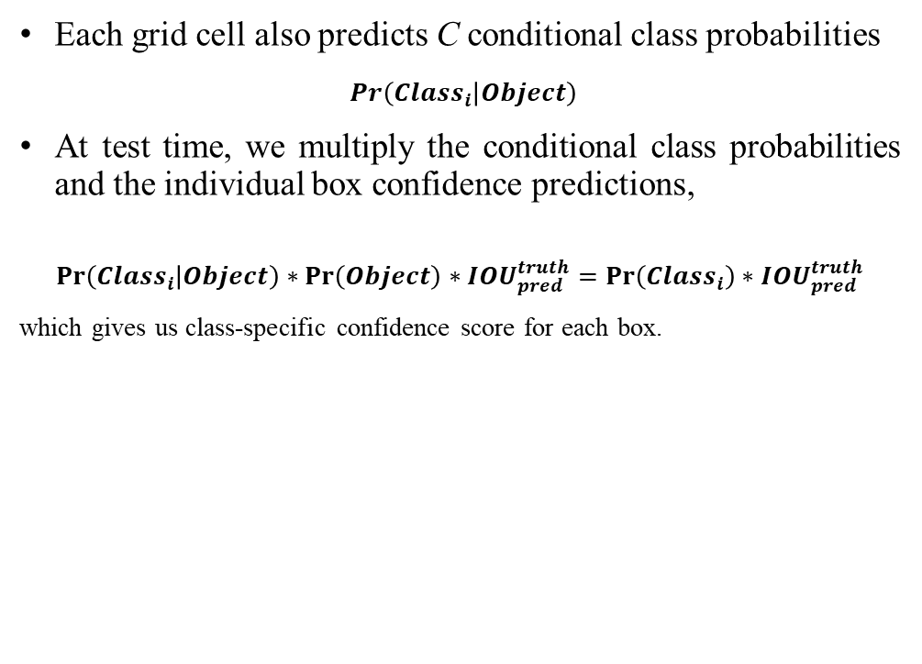
Unified Detection
Each bounding box consists of 5 predictions:
x
y
w
h
Confidence
(x,y) represents the center of bounding box. The h and w are predicted relative to the whole image. The confidence prediction represents the IOU between the predicted box and any ground truth box.
Each grid cell also predicts C conditional class probabilities
$\operatorname{Pr}\left({Class}_{i} | Object\right)$
At test time, we multiply the conditional class probabilities and the individual box confidence predictions,
$$\operatorname{Pr}\left({Class}_{i} | Object\right)∗\operatorname{Pr}\left(Object\right)∗{IOU}_{pred}^{truth}=\operatorname{Pr}\left({Class}_{i}\right)∗{IOU}_{pred}^{truth}$$
which gives us class-specific confidence score for each box.
$$Confidence= Pr\left(Object\right)∗{IOU}_{pred}^{truth}$$
Notes:
IOU: aka Intersection over union: Intersection over Union is an evaluation metric used to measure the accuracy of an object detector on a particular dataset.

Slide 11
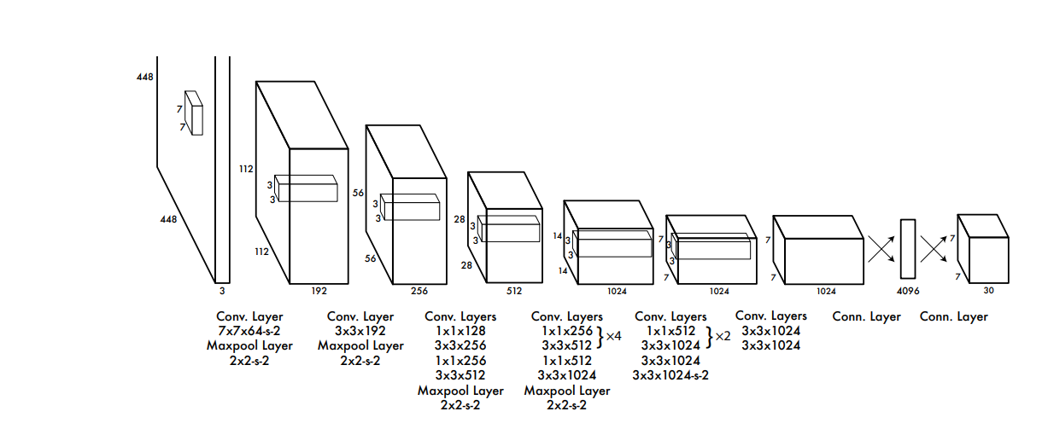
Network Design
The model is implemented as a convolutional neural network and evaluate it on the PASCAL VOC detection dataset.
The network has 24 convolutional layers followed by 2 fully connected layers.
Alternating 1 × 1 convolutional layers reduce the features space from preceding layers.
The final output of our network is the 7 × 7 × 30 tensor of predictions.

Slide 12
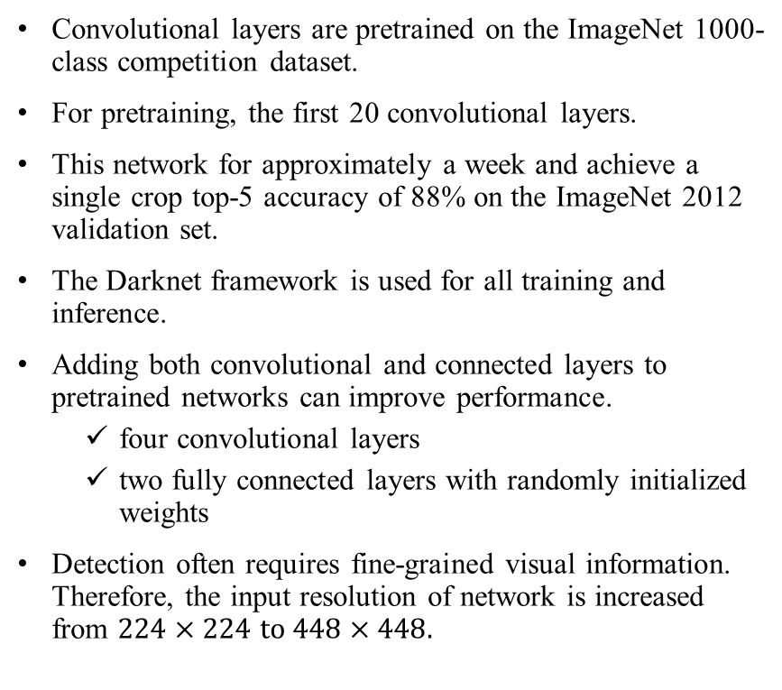
Training
Convolutional layers are pretrained on the ImageNet 1000-class competition dataset.
For pretraining, the first 20 convolutional layers.
This network for approximately a week and achieve a single crop top-5 accuracy of 88% on the ImageNet 2012 validation set.
The Darknet framework is used for all training and inference.
Adding both convolutional and connected layers to pretrained networks can improve performance.
four convolutional layers
two fully connected layers with randomly initialized weights
Detection often requires fine-grained visual information. Therefore, the input resolution of network is increased from $224×224$ to $448×448$.
Notes:
Darknet is a high performance open source framework for the implementation of neural networks. Advanced implementations of deep neural networks can be done using Darknet.

Slide 13
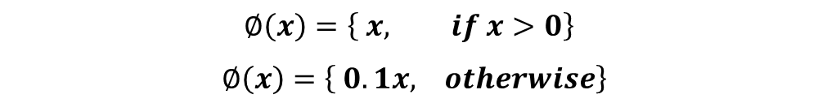
Training
Final layer predicts both class probabilities and bounding box coordinates.
The width and height of bounding box are normalized by the image width and height, so that they fall between 0 and 1.
A linear activation function is used for the final layer and all other layers use the following leaky rectified linear activation:
$$∅\left(x\right)=\left\{ x, if x>0\right\}$$
$∅\left(x\right)=\left\{ 0.1x, otherwise\right\}$

Slide 14
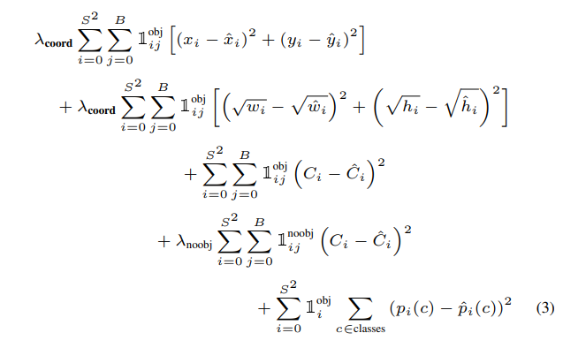
Training
The sum-squared error is used in the output of model.
The reason of using sum-squared error because it is easy to optimize.
Sum-squared error also equally weights errors in large boxes and small boxes.
The error metric should reflect that small deviations in large boxes matter less than in small boxes.
During the training we optimize the following loss function.

Slide 15
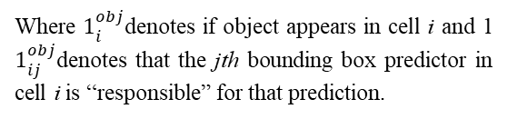
Training
Where $1_{i}^{obj}$denotes if object appears in cell i and 1 $1_{ij}^{obj}$denotes that the jth bounding box predictor in cell i is “responsible” for that prediction.
The loss function only penalizes:
classification error if an object is present in that grid cell.
bounding box coordinate error if that predictor is ‘responsible’ for the ground truth box.

Slide 16
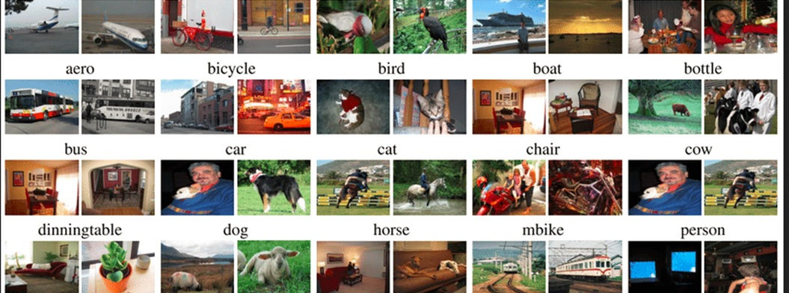
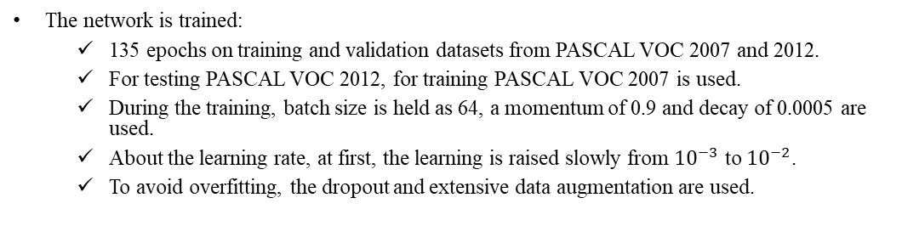
Training
The network is trained:
135 epochs on training and validation datasets from PASCAL VOC 2007 and 2012.
For testing PASCAL VOC 2012, for training PASCAL VOC 2007 is used.
During the training, batch size is held as 64, a momentum of 0.9 and decay of 0.0005 are used.
About the learning rate, at first, the learning is raised slowly from ${10}^{−3}$ to ${10}^{−2}$.
To avoid overfitting, the dropout and extensive data augmentation are used.
Notes:
If it is started at high learning rate, our model often diverges due to unstable gradients.
Data Augmentation

Slide 17
Limitations of YOLO
The model struggles with small objects that appear in groups.
Since the model learns to predict bounding boxes from data, it struggles to generalize to objects in new or unusual aspect ratios or configurations.
The model also uses relatively coarse features for predicting bounding boxes.

Slide 18
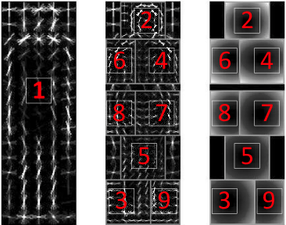
Comparison to Other Detection Systems
Deformable Parts Models (DPM) | YOLO
It uses sliding window approach. | It uses single unified network approach.
Its structure is like disjoint pipeline. | It replaces all disjoint parts into single convolutional neural network.
It is less faster and accurate then YOLO. | It is much more faster and accurate than DPM.
Notes:
The network performs feature extraction, bounding box prediction, non-maximal suppression, and contextual reasoning all concurrently.

Slide 19
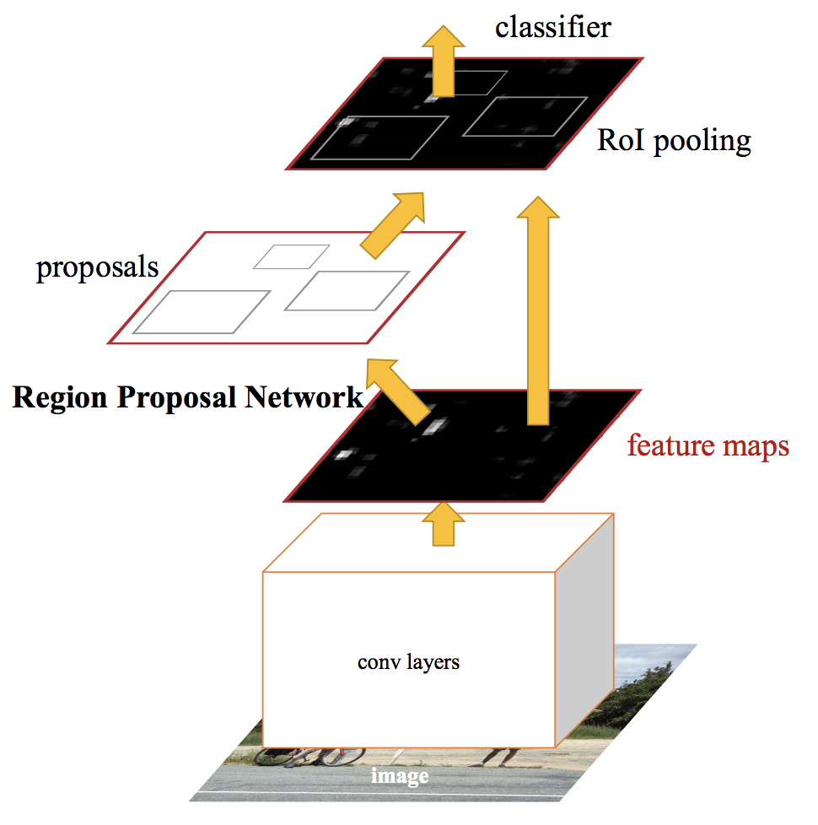
Comparison to Other Detection Systems
R-CNN | YOLO
It uses region proposals approach. | It uses single unified network approach.
Its process can be defined as below: Selective search generates potential bounding box. A CNN extract the features. SVM scores the boxes A linear model adjust the boxes. Non-suppression eliminates the duplicate detections. | It replaces all disjoint parts into single convolutional neural network.
Selective Search refers 2000 bounding boxes per image. | It refers 98 bounding boxes per image.

Slide 20
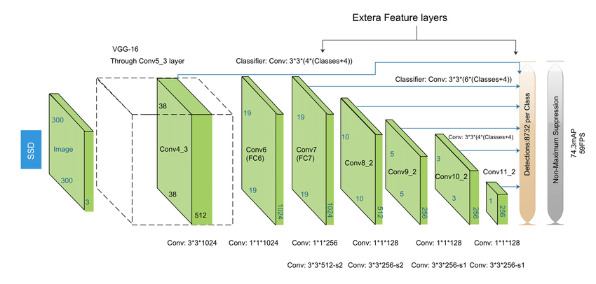
Comparison to Other Detection Systems
Deep MultiBox | YOLO
It uses CNN to predict regions instead of Selective Search. | It uses single unified network approach.
It can also perform single object detection but it cannot perform general object detection. | It can perform general object detection.

Slide 21
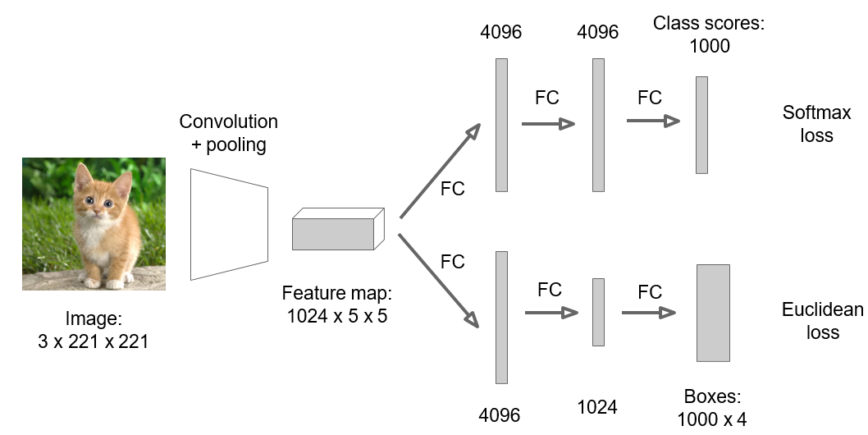
Comparison to Other Detection Systems
OverFeat | YOLO
It uses sliding window approach efficiently. | It uses single unified network approach.
It is a disjoint system. | It replaces all disjoint parts into single convolutional neural network.
It trains CNN to perform localization and optimizes for localization. | It optimizes detection performance.
It cannot reason global context. | It is much more convenient for global context.

Slide 22
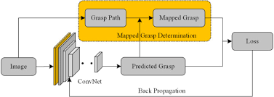
Comparison to Other Detection Systems
MultiGrasp | YOLO
The grid approach to bounding box prediction is based on regression to grasps. | It uses single unified network approach.
It only needs to predict a single graspable region for an image containing one object. | YOLO predicts both bounding boxes and class probabilities for multiple objects of multiple classes in an image.
It does not have to estimate the size, location or boundries of the object or predict its class. | It optimizes detection performance.

Slide 23
Experiments

Slide 24
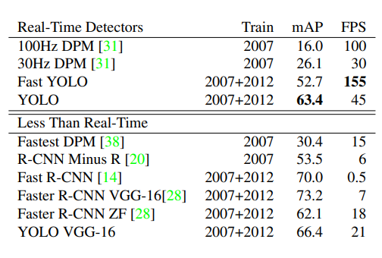
Comparison to Other Real Time Systems

Slide 25
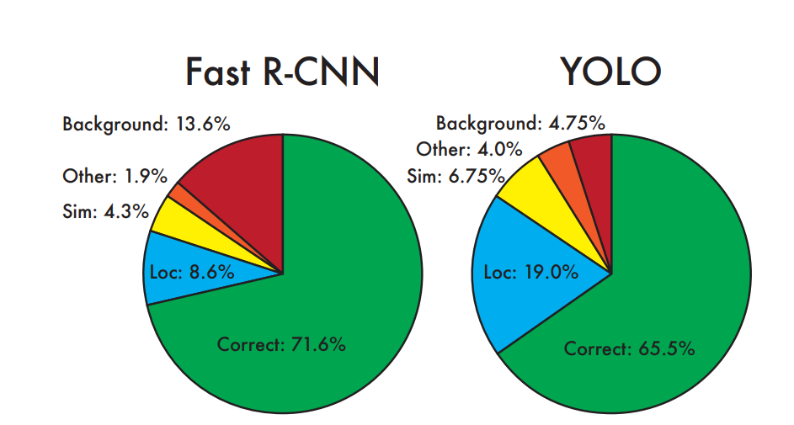
PASCAL VOC 2007 Error Analysis
The Figure shows the breakdown of each error type averaged across all 20 classes.
YOLO struggles to localize objects correctly.
Fast R-CNN makes much fewer localization errors but far more background errors.
Fast R-CNN is almost 3x more likely to predict background detections than YOLO.
Notes:
To further examine the differences between YOLO and state-of-the-art detectors, we look at detailed breakdown of results on VOC 2007

Slide 26
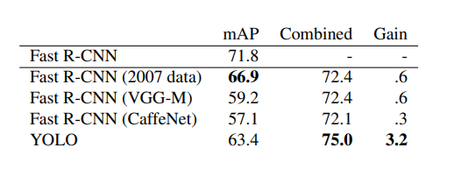
Combining Fast R-CNN and YOLO
YOLO makes far fewer background mistakes than Fast R-CNN. By using YOLO to eliminate background detections from Fast R-CNN, we get significant boost in performance.
The best Fast R-CNN model achieves a mAP of 71.8% on the VOC 2007 test set. When combined with YOLO, it is increasing to 75%.
Since YOLO is so fast, it does not add any significant computational time compared to Fast R-CNN

Slide 27
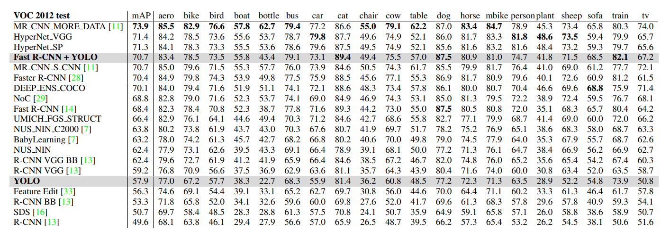
PASCAL VOC 2012 Error Analysis
On the VOC 2012 test set, YOLO scores 57.9% mAP. This is lower than the current state of the art.
On categories like bottle, sheep, and tv/monitor YOLO scores 8-10% lower than R-CNN or Feature Edit. However, on other categories like cat and train YOLO achieves higher performance.

Slide 28
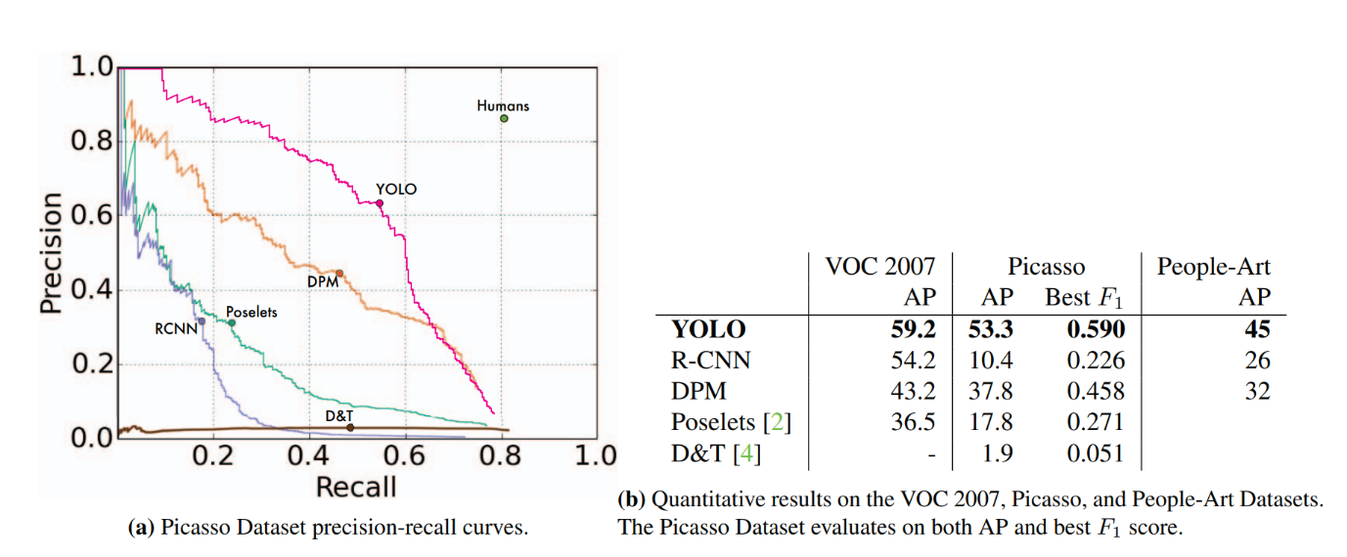
Generalizability: Person Detection in Artwork
The YOLO and the other detection systems are compared on Picasso dataset and the People-Art Dataset, two datasets for testing person detection on artwork.
R-CNN has high AP o VOC 2007. However, R-CNN drops off considerably when applied to artwork.
DPM maintains its AP well when applied to artwork. DPM works well because it has strong spatial models of the shape and layout of objects.
YOLO has good performance on VOC 2007 and its AP degrades less than other methods when applied to artwork.

Slide 29
Conclusion
YOLO is simple model to construct and can be trained directly on full images.
Unlike classifier-based approaches, YOLO is trained on a loss function that directly corresponds to detection performance and the entire model is trained jointly.
Fast YOLO is the fastest general-purpose object detection in the literature.
YOLO pushes the state-of-the-art in real-time object detection.
YOLO also generalizes well to new domains making it ideal for applications that rely on fast, robust object detection.

Slide 30

THANK YOU…

